Slide 1

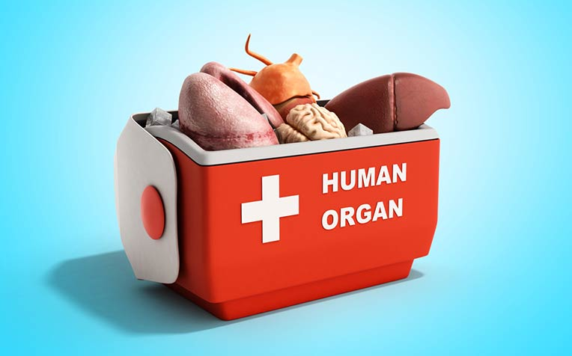
TRANSPLANTATION IMMUNOLOGY
Dr P. Mary Anupama
Assistant Professor
Dept. of Biochemistry
St. Joseph’s college for Women (A)
Visakhapatnam

Slide 2
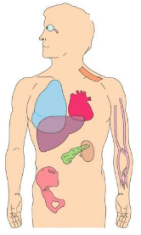
What is Transplantation?
Transplantation: It may be referred to as the act of transferring cells, tissues or organs form one site to another and some times from one individual to another.
Graft: The tissue or organ being transferred is called a graft or a transplant.
Donor: The individual donating graft.
Recipient: The individual receiving graft.

Slide 3

Transplantation Immunology
It is the study of the response of the immune system during transplantation.

Slide 4
Need for transplantation
Damaged organs
Injured organs
Non functional organs

Slide 5
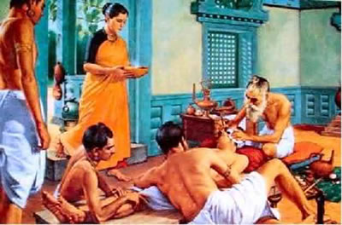
Early History
Skin graft reconstruction with patients own skin (Sustrutha Samhita)

Slide 6
First Human transplant was conducted in the year 1935 in Russia
Failed due to Blood group mismatch
First successful transplant was that of kidney in 1954
Started in 1912 with vascular transplantation
Successful skin transplantation by inducing tolerance in Mice in 1950.

Slide 7
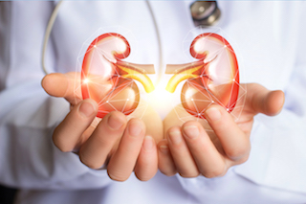
Transplantation in recent days
Today transplantations are being performed among non-identical individuals also.
It includes kidney, pancreas, heart, lung, liver, bone marrow and cornea transplantations.
They use immunosuppressive agents during grafting.
New methods are also being developed to induce specific tolerance to the graft.

Slide 8
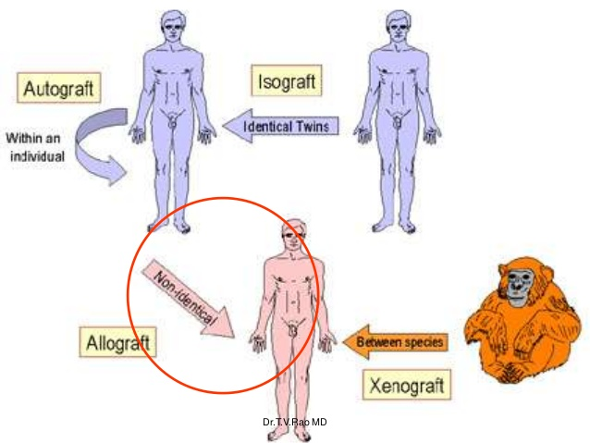
Types of grafts
a) Autograft: Transfer of self tissue from one body site to another. Eg: Skin grafts.
b) Isograft: Tissue transfer between genetically identical members twins
c) Allograft: Tissue transfer between genetically different members of same species.
d)Xenografts:Tissue transfer between different members of different species.

Slide 9
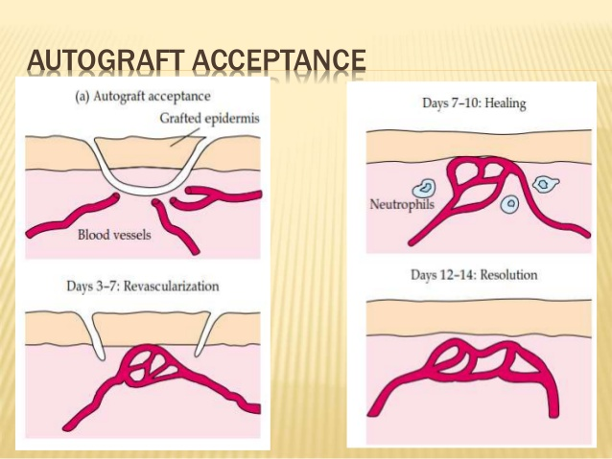
Acceptance of Grafts

Slide 10
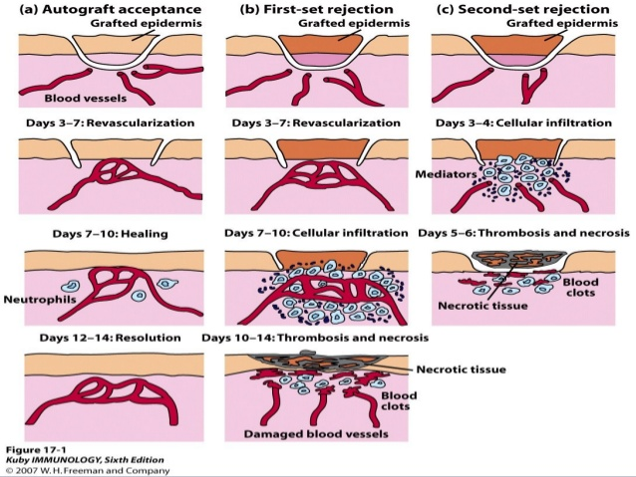
ALLOGRAFT REJECTION

Slide 11
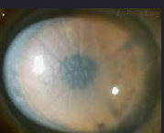
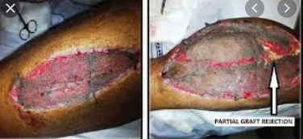
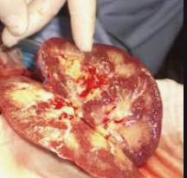
Corneal graft rejection
Partial skin graft rejection
Hyper acute rejection

Slide 12
Role of T cells in Graft rejection
In 1950, Avrion Mitchison showed that serum Abs
have no role in graft rejection. Only lymphocytes could transfer allograft immunity.
Eg: In nude mice which lack us thymus, both allografts and xenografts are accepted.
Thymus is the site for T cell development and maturation.
Since thymus is not there, no T cell development is there and hence grafts are accepted.

Slide 13
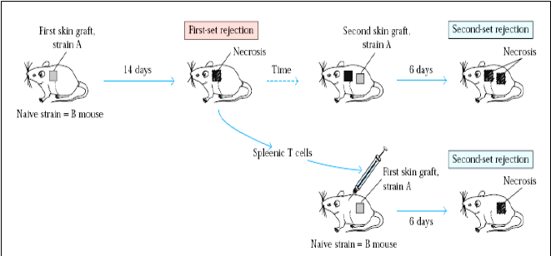
Transfer of T cell, transfers memory for graft rejection
Hence role of T cell is confirmed

Slide 14
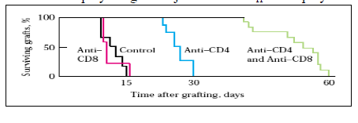
Confirmation of role of Tc cells and TH cells

Slide 15
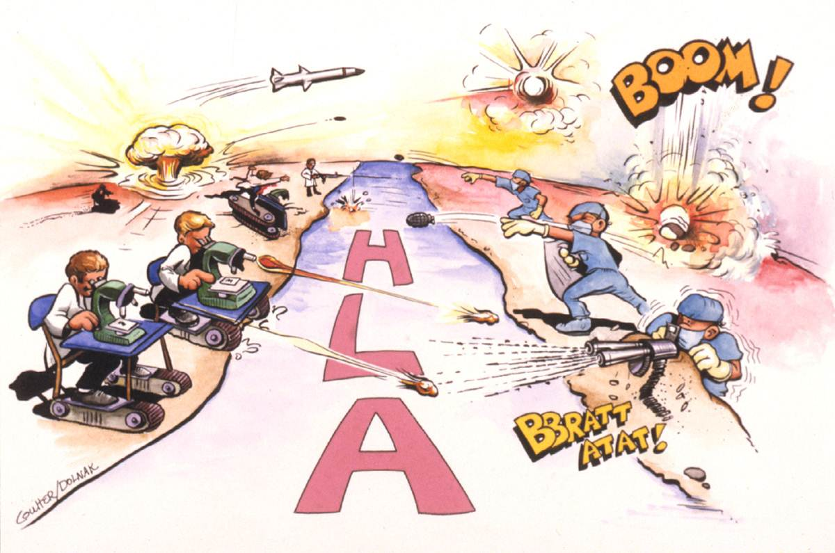
Role of MHC in allograft acceptance:

Slide 16
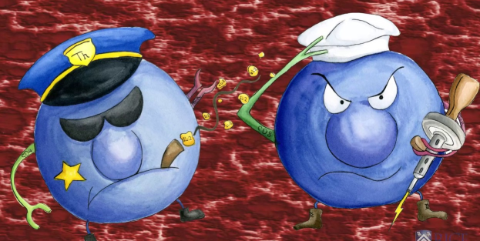
Role of HLA
There are 40 different loci for HLA which are responsible for allograft rejection reactions.
In out bred populations, a high degree of polymorphism is exhibited at each MHC locus and hence heterozygosity. There is only 25% chance that two off springs will inherit identical MHC haplotypes.

Slide 17
Cell mediated graft rejection
This is primarily due to MHC molecules (alloantigens) expressed on cells of the graft. The process of rejection occurs in two stages.
1. Sensitization phase: In this phase Ag-reactive lymphocytes of the recipient proliferate in response to MHC present on the graft.
2. Effector stage: In this phase, immune destruction of the graft will take place.

Slide 18
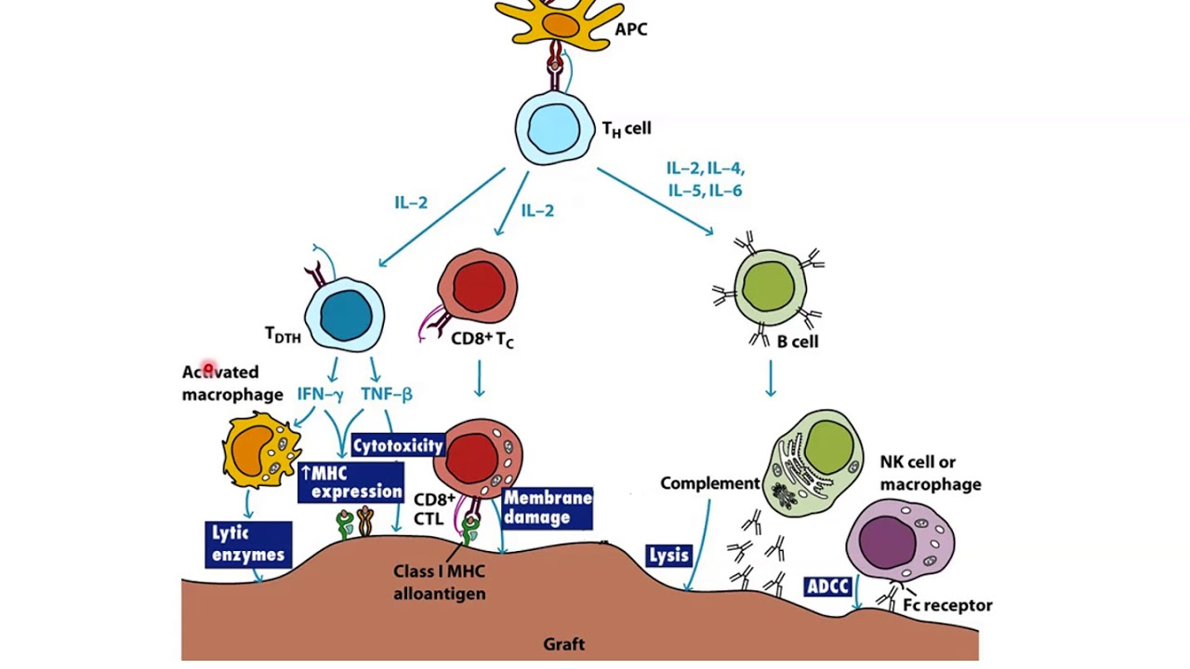

Slide 19
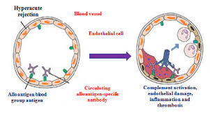
Clinical manifestations of graft rejection
a. Hyperacute rejections: They are caused by preexisting host serum Antibodies specific for Ags of the graft.

Slide 20
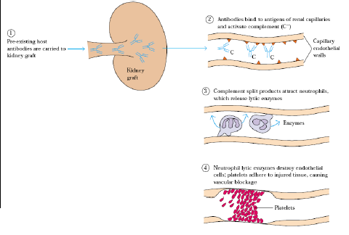

Slide 21
2. Acute rejection: Within 10days graft is rejected. Massive infiltration of macrophages and lymphocytes by TH cells takes place. Their activation and proliferation leads to graft rejection.
3. Chronic rejection: It develops in months or years. It includes both humoral and cell mediated responses by the recipient.

Slide 22
Tests to avoid graft rejection
Tissue typing, microcytotoxicity tests and mixed lymphocyte reactions are carried out to prevent graft rejection and see the tissue compatibility.
In kidney transplantations matching of MHC class I has little effect than that of MHC class II.
HLA compatibility is very important in kidney and bone marrow transplantations.
Liver and heart may survive even with greater mismatch.

Slide 23
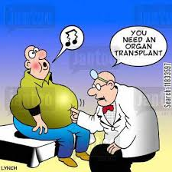
Immunosuppressive Therapy

Slide 24
1. Mitotic inhibitors:
a. Azathioprine: Blocks the synthesis of inosinic acid, the precursor of the purines adenylic and guanylic acid.
b. Cyclophosphamide: Alkylating agent. Gets inserted into DNA double helix and becomes cross linked. It is effective against dividing cells
c. Methotraxate: Folic acid antagonist, these block purine biosynthesis. All these inhibit mitosis non-specifically, how ever a decrease in T and B cell population is observed.

Slide 25
2. Corticosteroids- Prednisone and dexsmethasone are potent anti-inflammatory drugs.
3. Fungal metabolites-
Cyclosporin A and Tacrolinus: Block activation of resting T cells and inhibit transcription of genes encoding IL-2 and the high-affinity IL-2 receptor.
Rapamycin: Inhibits proliferation and differentiation of TH cells in G1 phase of cell cycle.
These are successfully used in kidney, liver, heart and bone marrow transplantations. Grafts survival is increased.

Slide 26
4. Total lymphoid elimination: Lymphocytes are sensitive to x-ray irradiation. If a person receives x-ray irradiation to the thymus, spleen and lymphnodes as per a typical protocol i.e., around 200rad/day for few weeks until 3400 radiations were administered and then grafted. The bone marrow which is not irradiated will form new lymphocytes which appear to be more tolerant to the Ags of the graft.
5. Specific immunosuppressive therapy: using mAbs against surface molecules of Tcells and to block costimulatory signals.

Slide 27
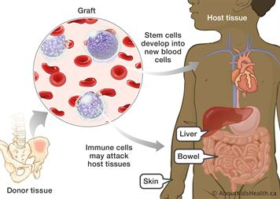
Graft versus Host reaction
Clinical Symptoms- Skin rash, person becomes thin, diarrhea, hepatomegaly, splenomegaly, increase in bilirubin production, bile duct gets damaged, anaemia, general immunosuppression.

Slide 28

DONATE ORGAN

Slide 29


Slide 30

THANK YOU

